Slide 1
Verdini et al. (2025). How to Connect Speech Foundation Models and Large Language Models? What Matters and What Does Not. Interspeech 2025

Slide 2
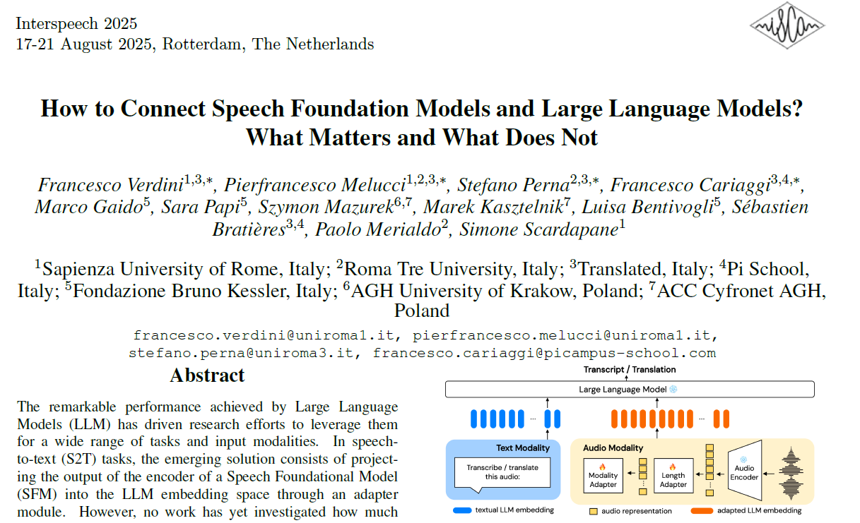

Slide 3
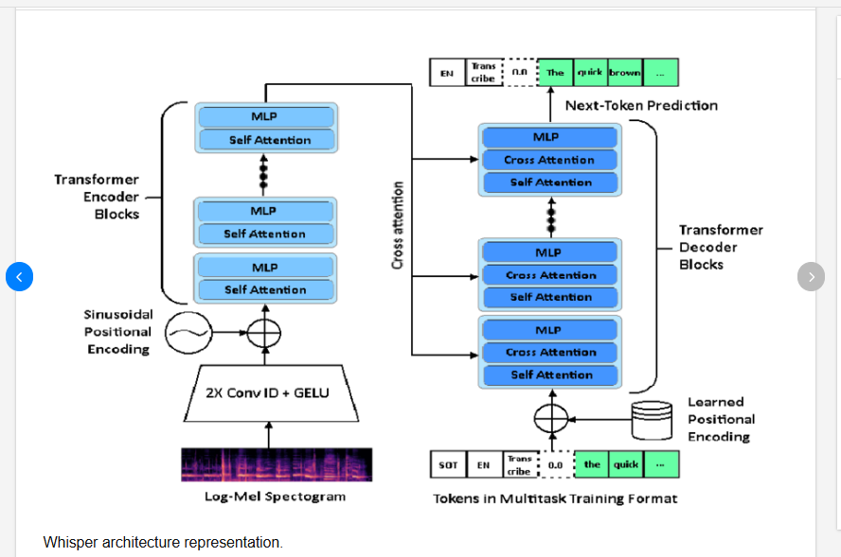
Whisper architecture

Slide 4
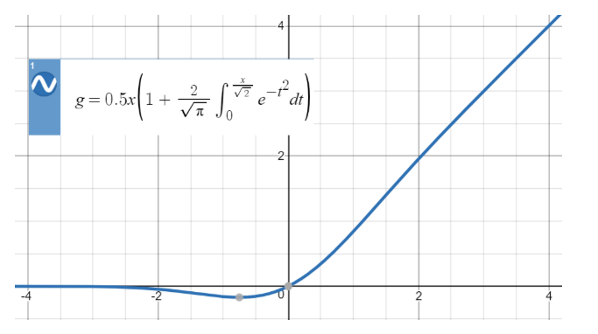
GELU (Gaussian error linear unit)

Slide 5
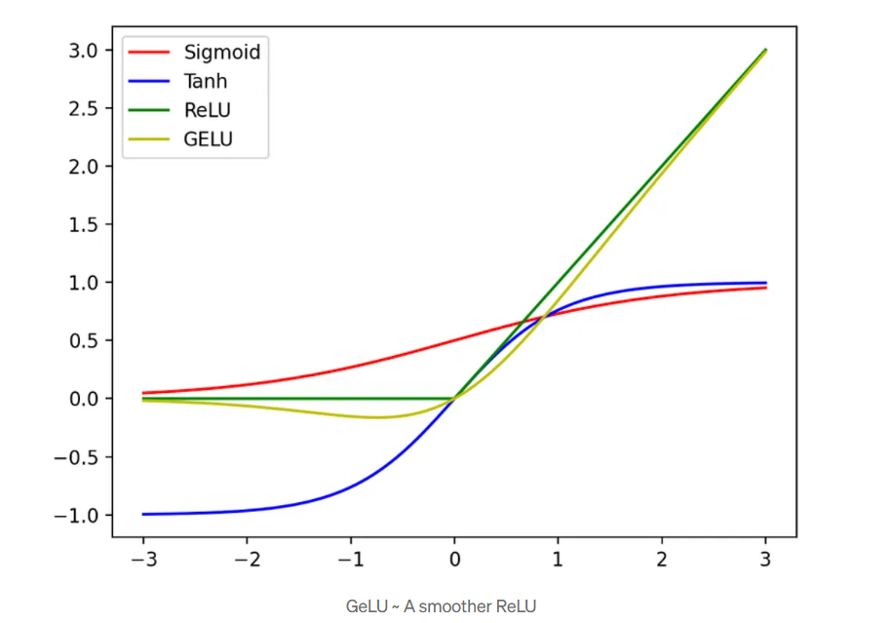

Slide 6
Verdini et al. (2025). How to Connect Speech Foundation Models and Large Language Models?
[…] In speech-to-text (S2T) tasks, the emerging solution consists of projecting the output of the encoder of a Speech Foundational Model (SFM) into the LLM embedding space through an adapter module.
However, no work has yet investigated how much the downstream-task performance depends on each component (SFM, adapter, LLM) nor whether the best design of the adapter depends on the chosen SFM and LLM.
To fill this gap, we evaluate the combination of 5 adapter modules, 2 LLMs (Mistral and Llama), and 2 SFMs (Whisper and SeamlessM4T) on two widespread S2T tasks, namely Automatic Speech Recognition and Speech Translation.

Slide 7
Focus on the “adapter”. How they argue:
Many architectural solutions have been proposed for the adapter
  often employed to both reduce the LLM computational costs and the modality mismatch with the textual sequences.
These methods span from fixed downsampling, obtained either with a stack of strided convolutions [9] or with window-level Q-Former [3], to modules with variable compression rates that reduce the input sequence based on its semantic content, such as Continuous Integrate-and-Fire (CIF) [10] and CTC compression [11].
Nonetheless, a comprehensive study on the adapter choice is missing

Slide 8
Procedure
explore impact on ASR and ST performance via systematic comparison of 20 different combinations:
5 adapters (proposed in the literature)
2 SFMs (Whisper-large-v3 [13] for ASR
  and SeamlessM4T v2-large[14] for ST
2 LLMs (Llama [1] and Mistral [15])

Slide 9
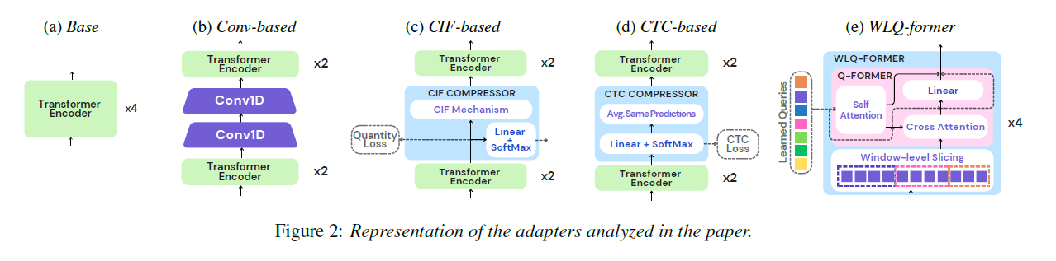
CIF = continuous integrate-and-fire
CTC = connectionist temporal classification
WL = window length
Q-former = transformer-based NN for cross-modal learning

Slide 10
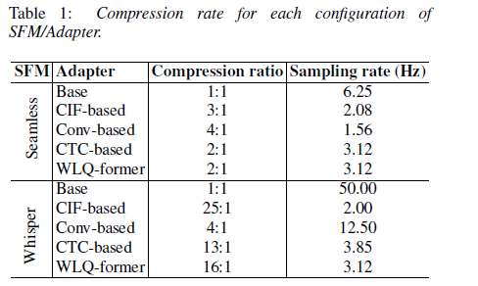
Product is 6.25 (1/16 sec)
Product is 50 (20ms frames)
Many other technical details (see paper)

Slide 11
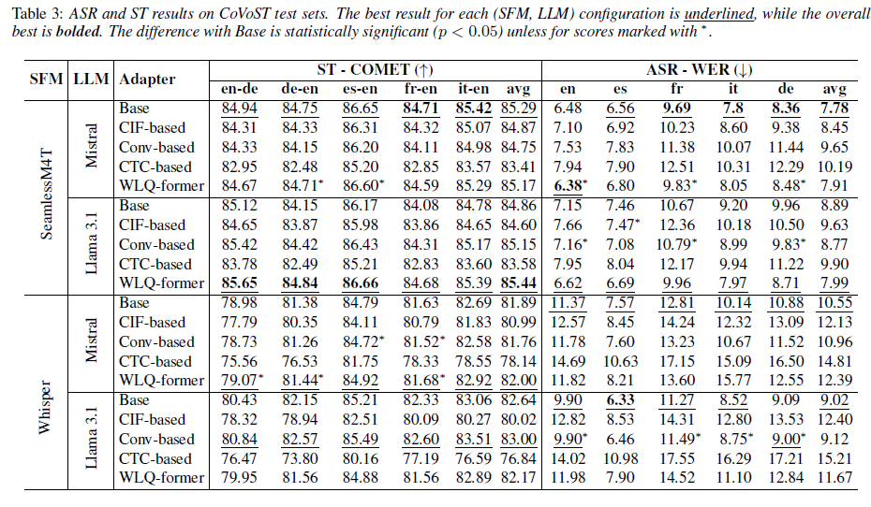

Slide 12
Conclusion
experiments covering two tasks (ASR and ST) and 5 languages
results demonstrate that the choice of the SFM is the most critical factor influencing downstream performance
there is no one-size-fits-all solution for the adapter
  the optimal choice varies depending on the specific combination of SFM and LLM.
the Base and WLQformer adapters, which feature very different compression factors, demonstrate strong performance across tasks
  suggesting that reducing sequence length mismatch between speech and text is less crucial than previously assumed.

Slide 13
Continuous Integrate-and-Fire (CIF)
Problem
Alignment between speech (a continuous-time sequence with many acoustic frames, like 100 frames per second) with text (discrete sequence).
CIF
neuroscience-inspired
is an alignment method for bridging speech encoders with text decoders like when combining a speech foundation model with a large language model. Once you have token-level embeddings via CIF, you can feed them directly into a large language model as if they were text embeddings.
Alignment without supervision: CIF automatically learns how many tokens to output and where to place them.

Slide 14
Continuous Integrate-and-Fire (CIF)
The idea is to treat each speech frame embedding as carrying a weight (like an "energy" or "charge").
Integration step
  At each time step t, the model computes a weight α_{t} (between 0 and 1).
  These weights accumulate over time
Fire step
  When the accumulated sum reaches 1.0 (a threshold), the model "fires.“
  At this point, a weighted average of the hidden states (speech encoder outputs) up to that point is produced as one output vector.
  This output corresponds to a single discrete unit (like one token embedding).
  Then the accumulator is reset (but if it overshoots 1.0, the surplus carries over).
Continuous
  Unlike a hard segmentation, CIF is differentiable. The weights α_{t}​ are predicted by the network and can be trained end-to-end with gradient descent.

Slide 15
